Slide 1
M269 Algorithms, data structures and computability
Introduction to the module
October 2023
The tutorial is due to begin at 19:00 and last for one and a half hours
While you wait, please run the audio set up wizard
You are welcome to use your microphone during the tutorial, please remember:
lf you are not using a headset, make sure that there is no feedback to your mic from your computer’s speakers
Keep your mic away from sources of external noise such as fans, for example
If you can, please keep your mic muted when you are not speaking

Slide 2
M269 Algorithms, data structures and computability
Dr James Burton
Introduction to the module
October 2023

Slide 3

01
Overview
A look at the module and each block
02
Software
Module specific software: Python, Jupyter notebooks
03
Assessment
An overview of the TMAs and EMA
04
Support
Your tutor, tutorials, forums and additional support
05
Checklist
Where are you up to, what should you be doing next
06
Q&A
An opportunity for questions and discussion

Slide 4
Overview

Slide 5

Overview
Where to begin
Forums
Tutor & Cluster Forums
Block Forums
News area
Resources
M269 Book
Module Guide
Jupyter Hub
Visualisations
Module structure
Study calendar (Accessible from Block 1 or resources)
TMA/EMA dates
Cross reference with other modules
OU Study app

Slide 6
Overview
M269 Book
Provides the teaching materials for the entire module
Available in several formats: PDF, HTML and Jupyter notebooks
The notebooks make this an interactive resource: experiment with code, complete the exercises
If you use several devices upload a copy to Jupyter Hub, your own playground for running notebooks and Python code
It is a big book. Look at the TMAs before working through the corresponding chapters to gauge what to study in depth, what to skim and what to skip.

Slide 7
Overview
Module Guide
Covers the aims and outcomes of the module
Explains the structure of the module
Explains how the module is assessed
Provides guidance on the word count rules for the module
Module Guide: 5.2 Word counts and referencing (open.ac.uk)
Explains plagiarism and referencing
Remember to provide citations and references
Cite them right
Quick guide to Harvard referencing (Cite Them Right) | Library Services | Open University

Slide 8
Overview
Standard information on word counts and referencing
Each TMA specifies a word count for each part which requires a text response.
Your submission will be marked up to the word count that has been set.
References are not included in the word count.
Captions and titles are also not included in the word count.
You are encouraged to provide appropriate references from reputable and high quality sources as a foundation for your answer.
Module Guide: 5.2 Word counts and referencing (open.ac.uk)

Slide 9

Overview
Forums, News & Resources
Cluster Forums
M269 Discussion Forum
Café Forum
Block Forums
Discussion
Software support
News
Errata!
News feed
Resources tab
Module guide
Jupyter Hub
Visualisation of data structures and algorithms

Slide 10
Overview
Module structure
M269 is a 30-credit module over 30 weeks, so expect to work for an average of 10 hours per week.
If you’re studying part-time, I strongly advise you to do at most one other 30-credit module in parallel to M269.
Each week usually corresponds to one book chapter.
The material gets progressively harder, so early weeks like this one don’t require 10 hours to read and work through, while others may require more.
Get ahead of the study planner whenever you can.

Slide 11
Overview
Module structure
Three blocks, based on the book
Numbers and sequences
Search, sorting, trees and graphs
Complexity and computability
Three TMAs
Linked to each block
Written responses required but mostly technical: code, algorithms and technical specifications
Equal weighting
No EMA (but TMA03 is treated like an EMA)

Slide 12
Overview
Block 1
Block 1: Basic data structures and algorithms, Weeks 1-11
Numbers and sequence
Booleans and selection
Sequence and iteration
TMA01 Part 1
Implementing sequences
Stacks and queues
Unordered collections
TMA01 Part 2
Work on the exercises from the book throughout
Notes:
This block starts with a review of several web areas that you may be familiar with if you studied TT284, if you didn’t that’s okay.
We go on to look at web services, in particular REST.
What is REST?
We contrast rest with SOAP.
What is SOAP?
How do REST and Soap differ?
Why is one better than the other?
We look at the protocols used by REST and SOAP (HTTP, DNS) and markup (HTML, XHTML, CSS, XML), standards and standardisation organisations (W3C, IETF working groups), as well as Security (firewalls, HTTPS, digital certificates).
This is supported by practical work in NetBeans.

Slide 13
Overview
Block 2
Block 2: Search, sorting and more data structures, Weeks 12-23
Exhaustive search
Recursion
Divide and Conquer
Sorting
TMA02 Part 1
Trees
Graphs
Greedy algorithms
TMA02 Part 2
Notes:
Cordova – used for developing a mobile app that will be deployed to an Android device (virtual on OpenStack or physical if you have one)
This block looks at the marketplace for mobile apps and the multiplicity of different devices and platforms:
Types of mobile device, operating systems.
Considering how developers manage in this environment – web apps, native development, hybrid apps (developed cross platform in a container that gives the app access to the devices hardware without the need for native coding).
We will develop a mobile app using Cordova which will utilise the devices hardware and interact with cloud-based data, drawing together things learnt in blocks 1 and 2.

Slide 14
Overview
Block 3
Block 3: More algorithms, computability and complexity, Weeks 24-30
More graphs
Backtracking
Dynamic programming
TMA03 Part 1
Complexity classes
Computability
TMA03 Part 2
Notes:
What is the cloud?
How can it be used to resource applications in new ways.
Compute, database, storage, networking
Provisioning machines, OSs, services
SAAS,IAAS,PAAS
Practical experience in creating cloud networking, security, virtualisation and resource management using OpenStack and AWS (Azure). A lot of weeks here for researching platforms.
Benefits of cloud, for example cost for startup (little up front investment, low risk), scale up, scale out.
Disadvantages of cloud, for example ongoing cost, ownership of data, security

Slide 15



Overview
OU Study App
OU Study is the companion app for OU Module websites
Always have your study planner to hand
Access to your learning materials on the go
Download your learning materials to use offline
OU Study | Apps at the OU (open.ac.uk)

Slide 16
Software

Slide 17
Software
Python 3
Jupyter notebooks
An IDE
You could do all of your work on Jupyter Hub, the online platform for running notebooks.
Better to have everything set up locally too – more flexible, more responsive, works offline.
Notes:
OpenStack access provided by OU
AWS free account
Cordova – check version required when block materials released
Android device with developer options on, virtual device on OpenStack
Videos in resources relating to AWS and Cordova – best viewed when studying those blocks

Slide 18
Assessment

Slide 19
Assessment
Full study calendar available on module website under Resources tab
Three TMAs, weighted 30%, 30% and 40% (in this order)
You must submit TMA03 (even if you only put your name on it) or you cannot pass the module
No extension for TMA03
Notes:
TMA01 due 17th Nov THURSDAY
TMA02 due 9th Feb THURSDAY
TMA03 due 20th April THURSDAY
EMA due 6th June TUESDAY

Slide 20
Assessment
Content of TMAs
Each TMA requires you to demonstrate understanding and learning by:
Writing code
Explaining your choice of data structures and algorithms
Producing technical specifications of problems and solutions
Notes:
Short report written in context of the scenario. Remember to pitch the report to Mike, a non-technical executive at MegaMax. As well as discussing the advantages and disadvantages of each option, you should demonstrate what you understand by the term web service and outline any key differences between REST and SOAP (Block 1 Part 3 should help with this). Use good references support your answer. Harvard referencing for citations.
Outline how security concerns over exchange of data between remote devices and central server over the internet could be addressed. Again, this is part of the report pitched to Mike. Address security in terms of secure transmission of data.
Still part of the report pitched to Mike at MegaMax, this serves to demonstrate how you might deploy and test a RESTful service:
Follow the method
Save changes as you go (version control), if you break it rollback
Remember to take all the required screenshots. Label the screenshots and reference them in the report as required.
Breakdown of marks available at the end of the TMA, use it to inform how you balance your answer and word count.
https://learn2.open.ac.uk/mod/oucontent/view.php?id=2015388&section=4

Slide 21
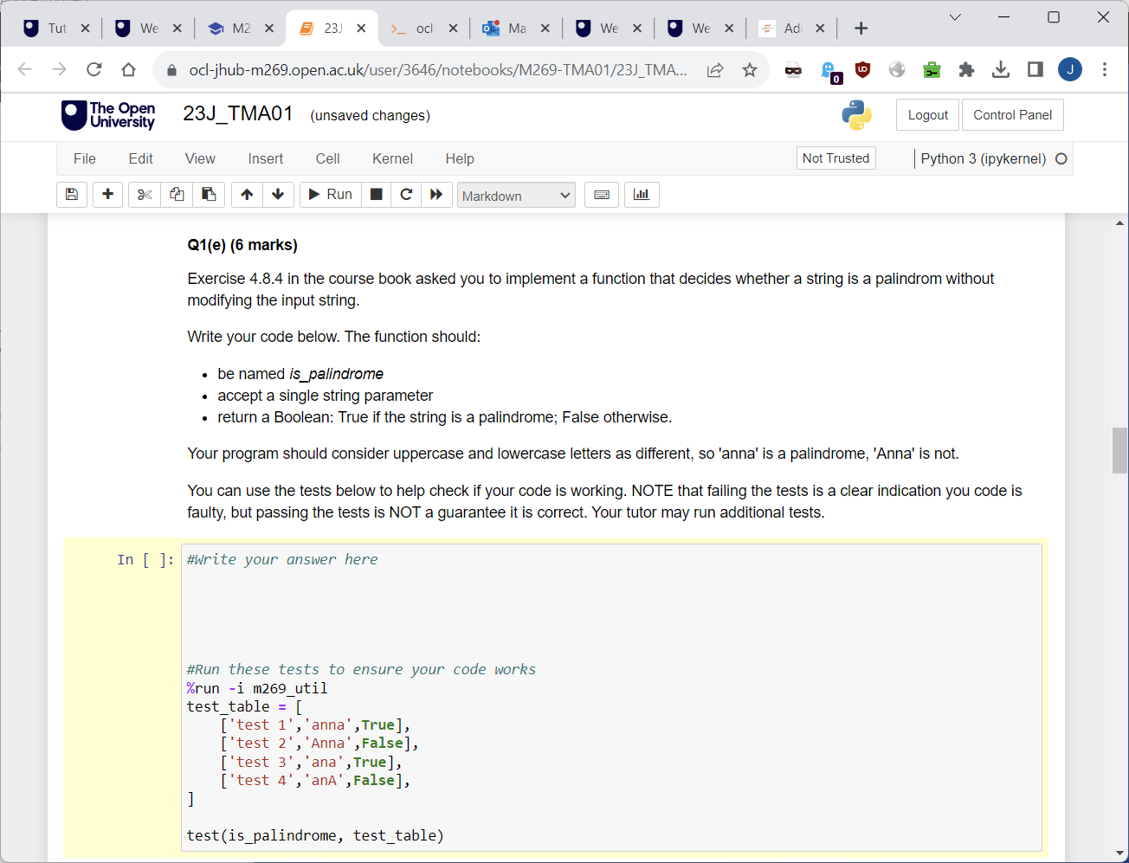
Assessment
Notes:
Short report written in context of the scenario. Remember to pitch the report to Mike, a non-technical executive at MegaMax. As well as discussing the advantages and disadvantages of each option, you should demonstrate what you understand by the term web service and outline any key differences between REST and SOAP (Block 1 Part 3 should help with this). Use good references support your answer. Harvard referencing for citations.
Outline how security concerns over exchange of data between remote devices and central server over the internet could be addressed. Again, this is part of the report pitched to Mike. Address security in terms of secure transmission of data.
Still part of the report pitched to Mike at MegaMax, this serves to demonstrate how you might deploy and test a RESTful service:
Follow the method
Save changes as you go (version control), if you break it rollback
Remember to take all the required screenshots. Label the screenshots and reference them in the report as required.
Breakdown of marks available at the end of the TMA, use it to inform how you balance your answer and word count.
https://learn2.open.ac.uk/mod/oucontent/view.php?id=2015388&section=4

Slide 22
Assessment
If it is found that you have used the services of a website, online service or social media platform, or that you have otherwise obtained the work you submit from another person, this is considered serious academic misconduct.
Notes:
3 TMAs and the EMA
The 3 TMAs are the continuous assessment element, at least 40% needs to be scored from this element so 40% across the three TMAs. The TMAs are equally weighted.
Substitution does not apply on TM352
The EMA is the examinable component… there is no examination.
The assessment is equally weighted, 50% of the overall grade comes from the TMAs, and 50% from the EMA

Slide 23
Support

Slide 24
Support
Tutor
Ask for help and advice when needed
TMA feedback
Tutorials
Most have a specific theme: search, sorting, trees etc
TMA ‘Don’t panic’ sessions
EMA sessions
Q&A sessions (questions submitted in advance)
Attend any you want/need to
Some will be recorded
Forums
Library services
Notes:
Tutors are available to help and should have let you know the best way to get in touch.
Read the feedback you get on your assignments it will help guide you.
If you need any adjustments, ask.
If you are falling behind, get in touch.
If you need clarification on anything, ask.
All questions are good questions.
You can attend any tutorial, not just those delivered by your tutor.
Some tutorials will be recorded.
If you have difficulties, checking the Forums to see if anyone else has had the same issue is often a good solution. Or providing a solution yourself to someone else’s problem… or your own. Or just drop in for a chat with your fellow students.
Library services – accessible from the Resources page. At Level 3 you should be seeking external references for your TMAs and the OU Library holds a wealth of resources including eBooks, Journals and Reports.

Slide 25
Support
Study Tips
Follow the study calendar
Designate study time
Complete practical activities as they come up
Read through the TMAs as soon as you get to that block
Save work regularly – use OneDrive/Microsoft 365 for automatic saving and version history
Notes:
Try not to drop behind, try not to get too far ahead.
Block 2 not yet released and Block 3 not released until January so you could lose steam if waiting.
Print the Calendar, add key dates to your own calendar/phone, set reminders
Completing the practical activities helps consolidate learning, they are placed in particular places in the material for this purpose.
Reading the TMA early will help you identify pertinent parts of the module text.
Print it off and highlight key parts, annotate it as you find relevant material in the Module text.
Create a template file with a cover page, contents page, appropriate header and footer (OU Personal Identifier, your name, Module code, TMA number, page numbers (x of y), references section).
When working on practical elements or TMAs/EMA, save your work regularly and keep a backup. Microsoft 365 apps, autosave and OneDrive has version history.
If you are familiar with source control consider using it for your practical work.

Slide 26



ousa@open.ac.uk
Community
Meet other students
Join a Society
Create a Club
Apply for University Challenge
Sign up for news
Volunteering opportunities
Visit our OU shop
Support
Talk to a Peer Supporter
Contact Nightline
Explore Togetherall
Disabled Students Group
BAME students Group
PLEXUS (LGBT+) Group
Mental Health Resources
Help and Guidance
Representation
Find out how the Association represents you
Want to feedback to the OU?
Represent your fellow students in OU meetings
Find out about all these and more at www.oustudents.com

Slide 27
Checklist
Notes:
Where is everyone up to?

Slide 28
What next
Download study calendar and the book
Make a note of important dates
Install Python 3, Jupyter and an IDE of your choice
Read TMA 01

Slide 29
Q&A

Slide 30
Thanks for taking part and I hope you have fun!

